Slide 1
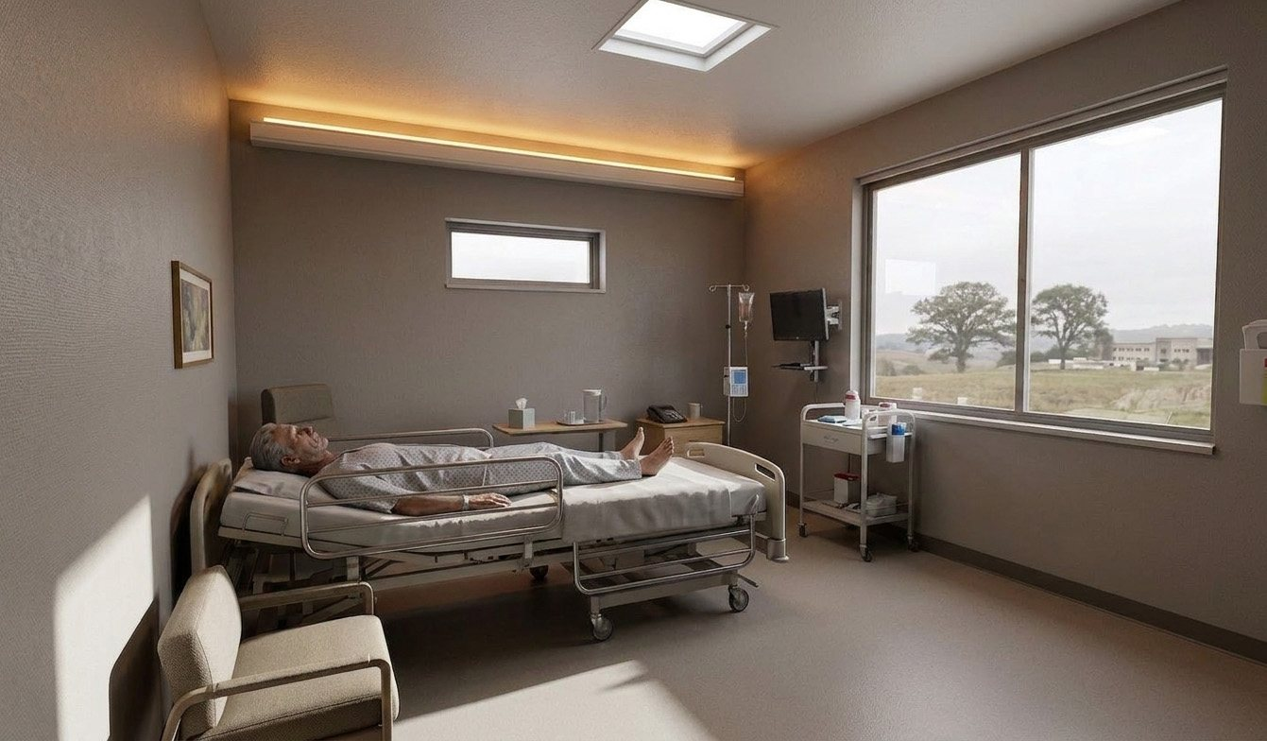
Patient Room Lighting Study
Six fixture layouts for a 14 x 12 ft room, compared in Circadian Lab

Slide 2
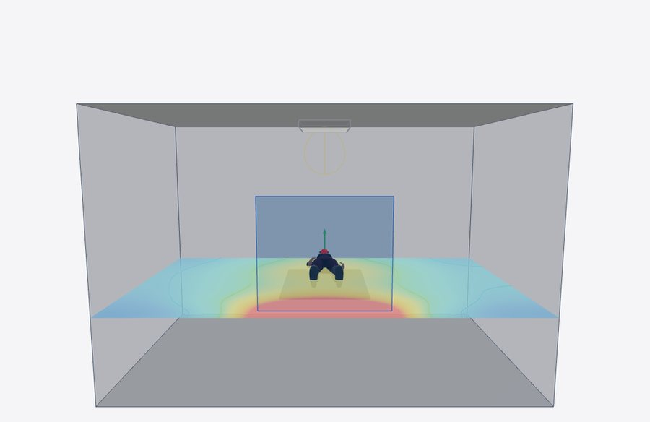
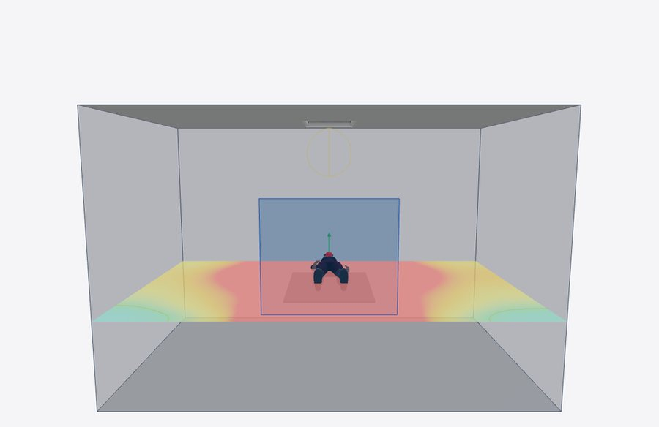
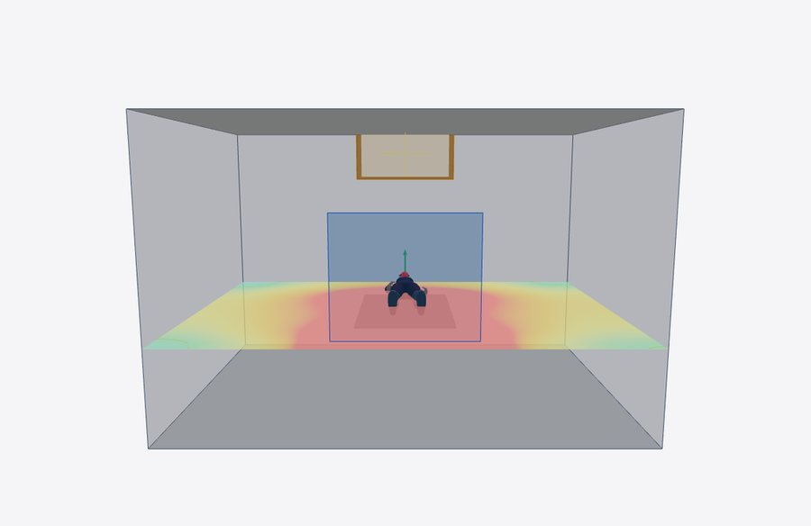
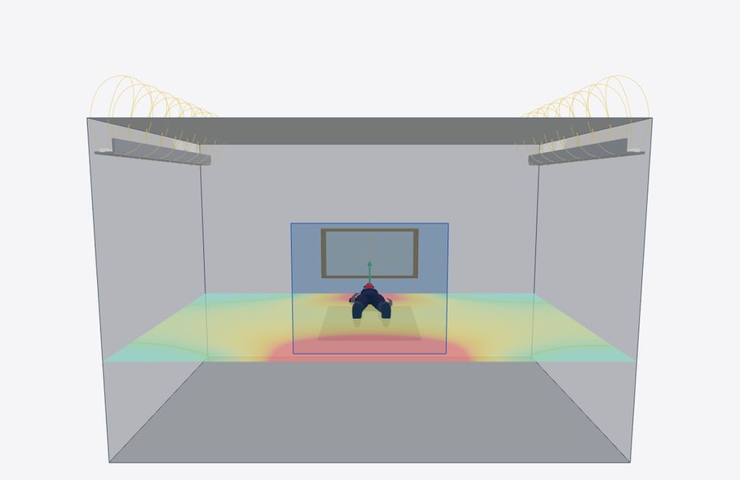
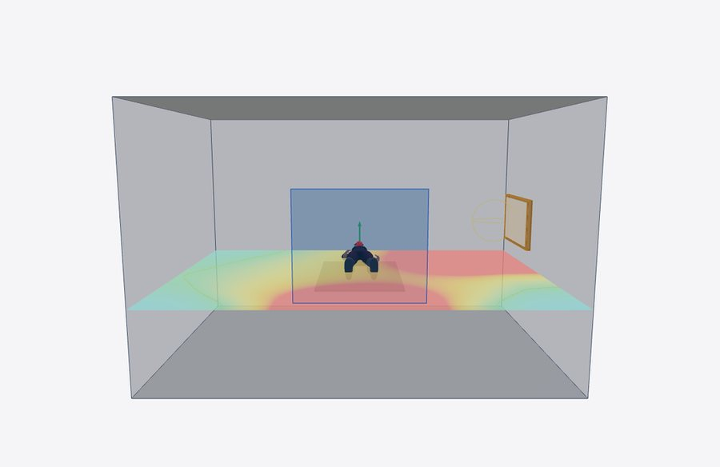
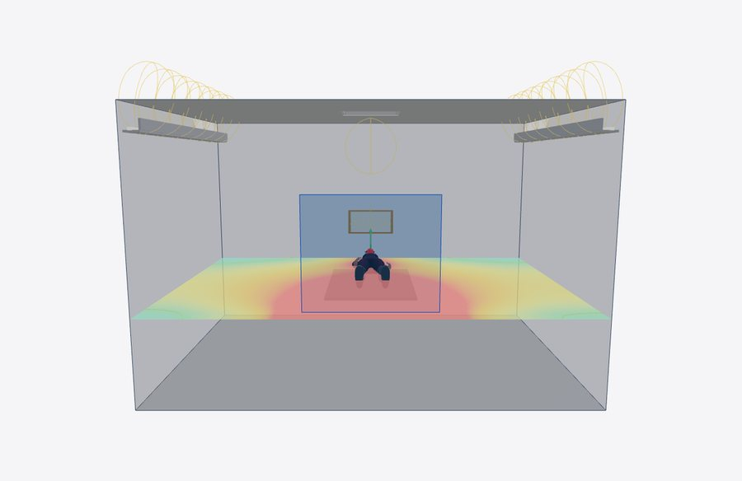
Six ways to light the same room
Same bed, same window, same targets: 250 mel-EDI at the eye and UGR 22 or below
1. Conventional troffer
2. Ceiling panel
3. Headwall panel
4. Cove + headwall
5. Side-wall panel
6. Cove + headwall + overbed

Slide 3
Circadian light at the eye
Melanopic EDI for a patient lying flat, electric light only. Blue: also meets the glare limit; amber: too much glare

Slide 4
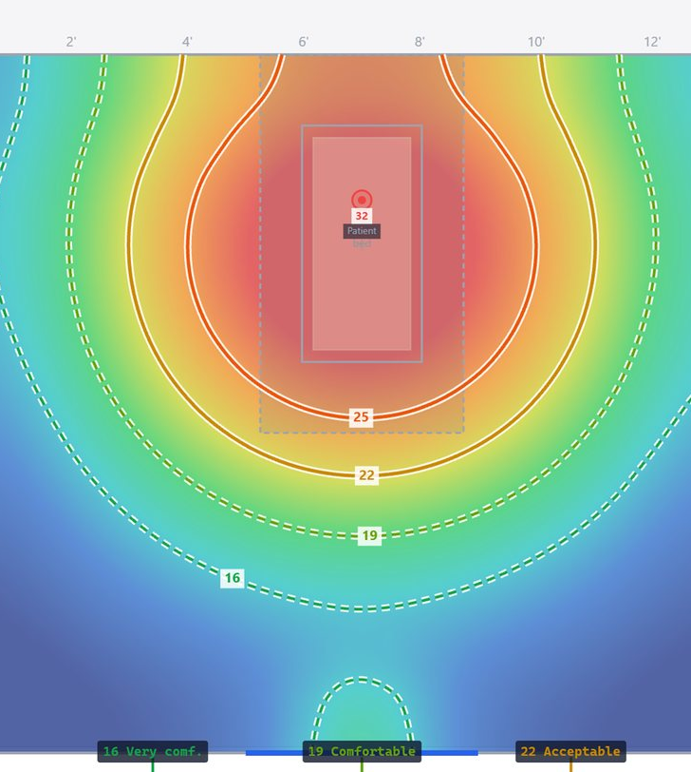
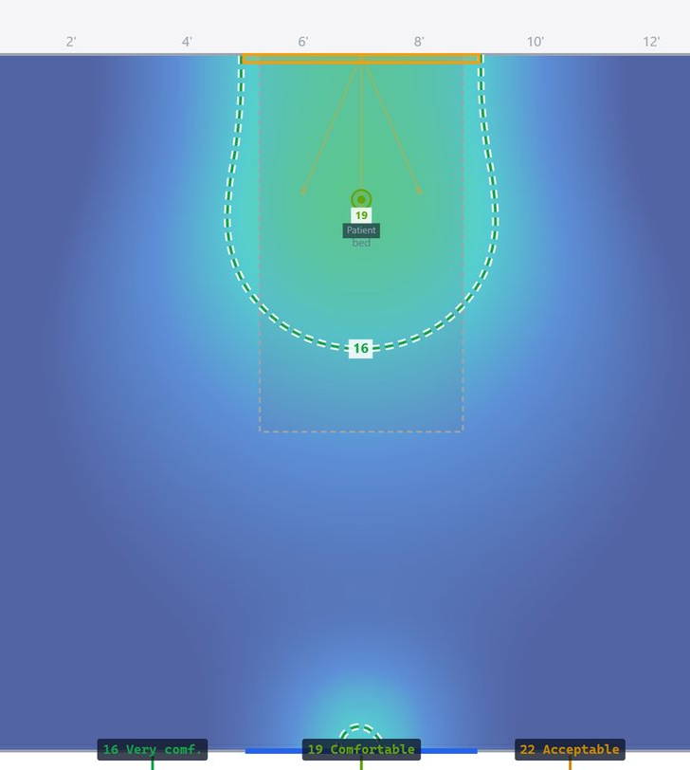
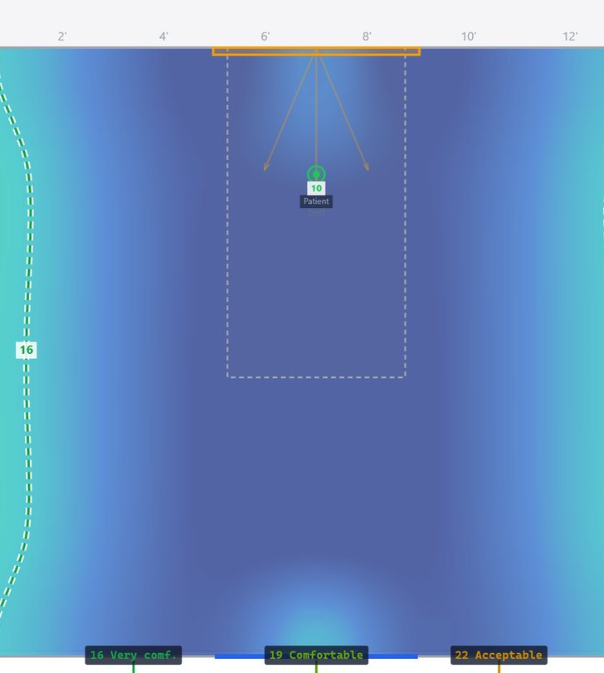
Glare for a patient looking up
UGR plans: red is intolerable, green is comfortable
Ceiling panel: UGR 33.6
Headwall panel: UGR 19.7
Cove + headwall: UGR 11.7

Slide 5
Results at a glance
Targets: 250 mel-EDI or more, UGR 22 or less (19 or less for the exam)
Design | mel-EDI | UGR | Verdict
Conventional troffer | 280 | 32.8 | Too much glare
Ceiling panel | 867 | 33.6 | Too much glare
Headwall panel | 513 | 19.7 | Meets both
Cove + headwall | 365 | 11.7 | Meets both
Side-wall panel | 277 | 11.6 | Meets both
Cove + headwall + overbed | 444 | 18.4 | Meets both

Slide 6
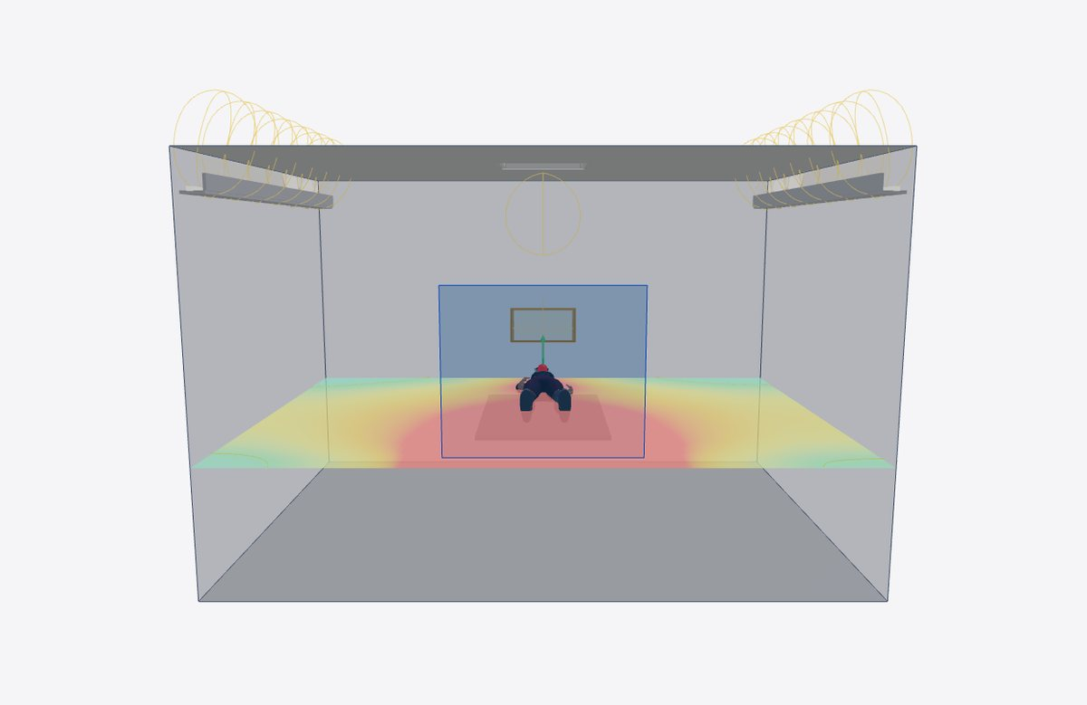
Recommended: three sources, one job each
Holds 250 mel-EDI in every bed position with comfortable glare
Warm 3000 K cove
A soft, calming ceiling for comfort
Headwall panel
Carries the dose while lying flat
Overbed 2x2 panel
Carries the dose sitting up

