Slide 1
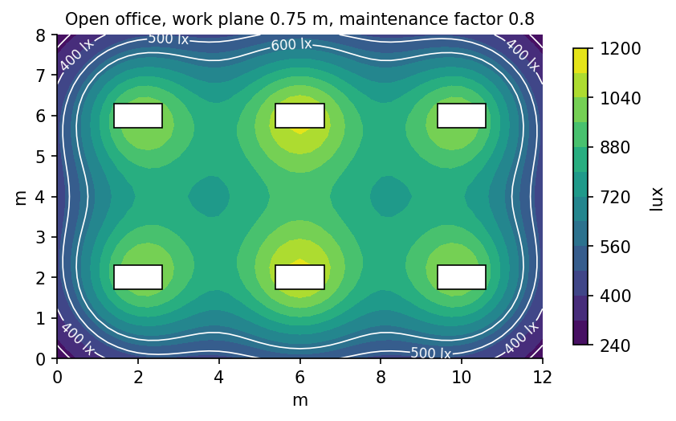
Level 3 Office Lighting Review
Design review meeting
Illuminance, glare and controls

Slide 2
Open office illuminance
• Average 532 lux on the work plane
• Minimum 341 lux, uniformity 0.64
• UGR 17 looking along the bay
• Six 600 x 1200 panels per 12 x 8 m bay
2

Slide 3
Target and calculated illuminance (lux)
3

Slide 4
Luminaire types
Type | Description | lm | W | CCT | Qty
L1 | Recessed panel 600 x 1200 | 4400 | 34 | 4000 K | 96
L2 | Recessed panel 600 x 600 | 3200 | 26 | 4000 K | 20
L3 | Downlight 150 dia. | 1800 | 15 | 3000 K | 34
L4 | Linear pendant up/down | 5200 | 42 | 3500 K | 9
4

Slide 5
Meeting room 2 is below target
• 388 lux against 400 lux target
• Cause: dark timber wall finish (25% reflectance) on two walls
• Option A: add one L2 panel (+60 lux, +26 W)
• Option B: raise L2 output 10% via DALI (+39 lux, +3 W)
• Recommended: option B, no extra fixture
5

